Slide 1
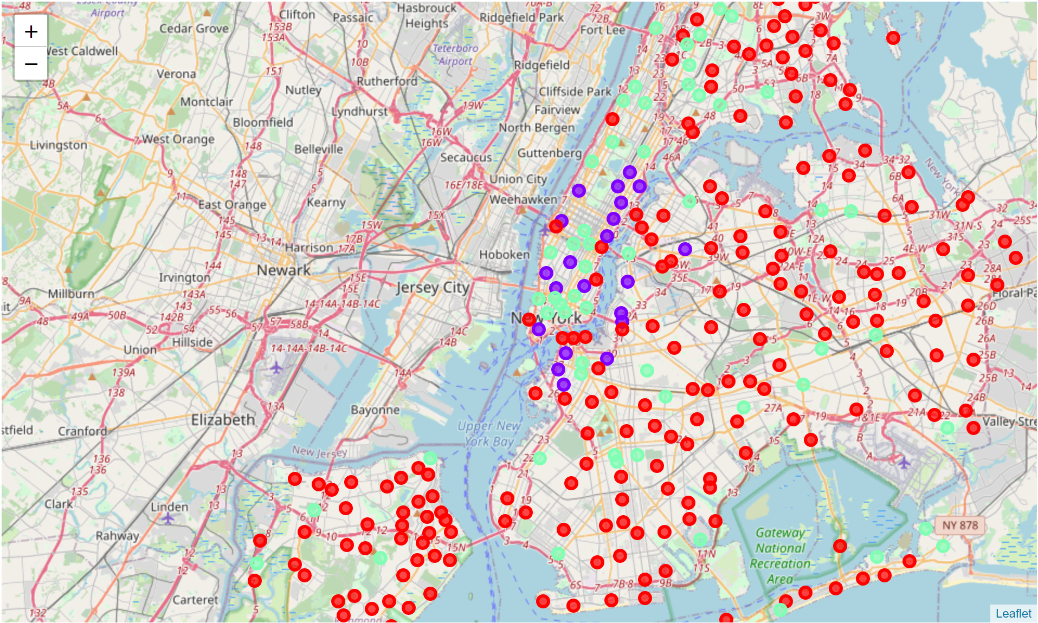
Cluster Label | Color
-1
0
1

Slide 2
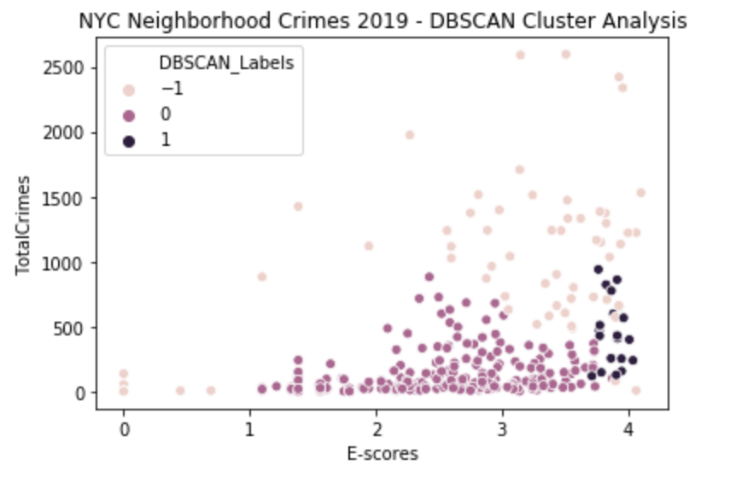

Slide 3
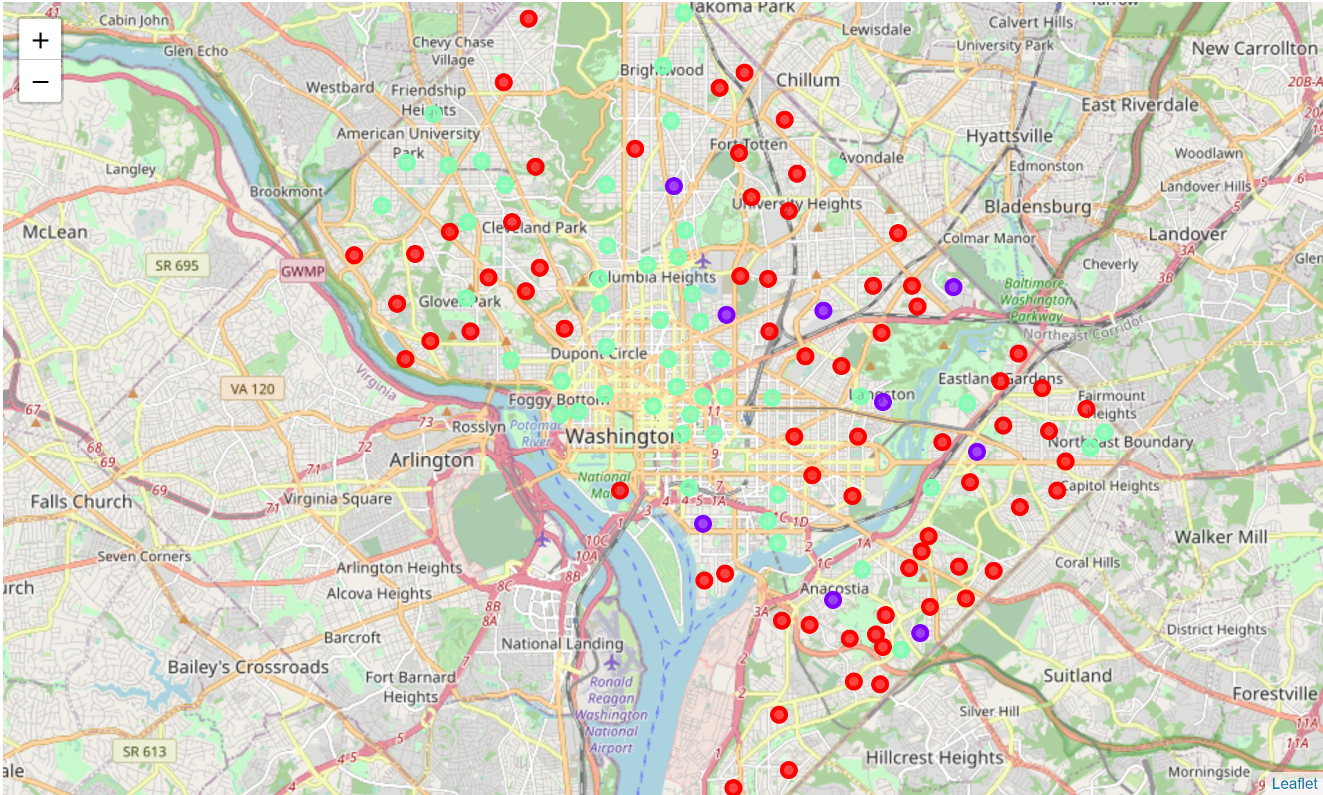
Cluster Label | Color
-1
0
1

Slide 4
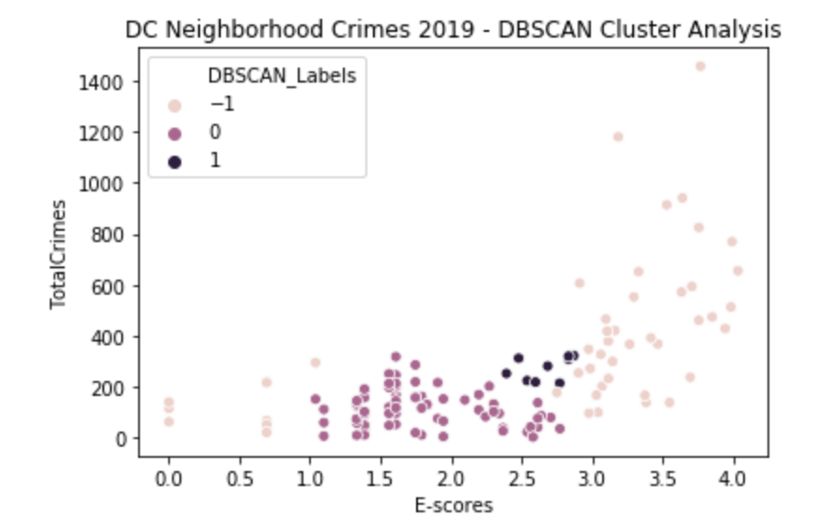

Slide 5
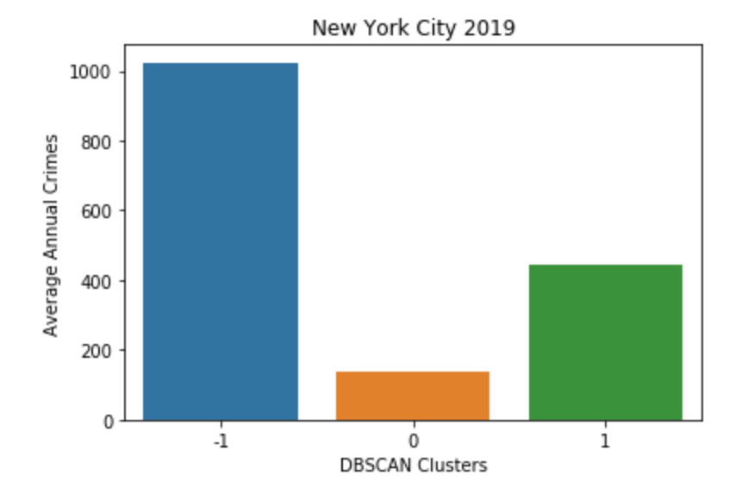
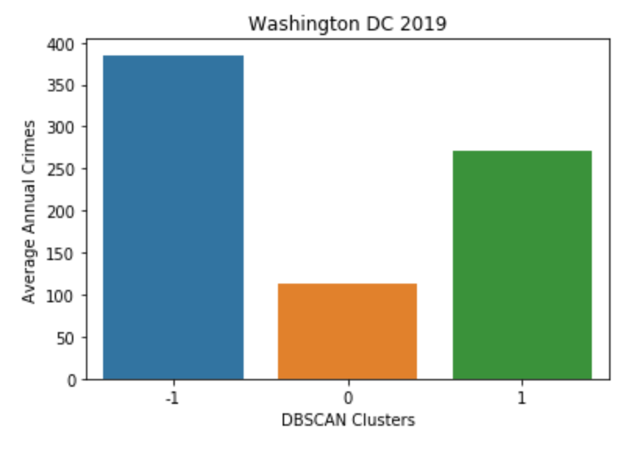
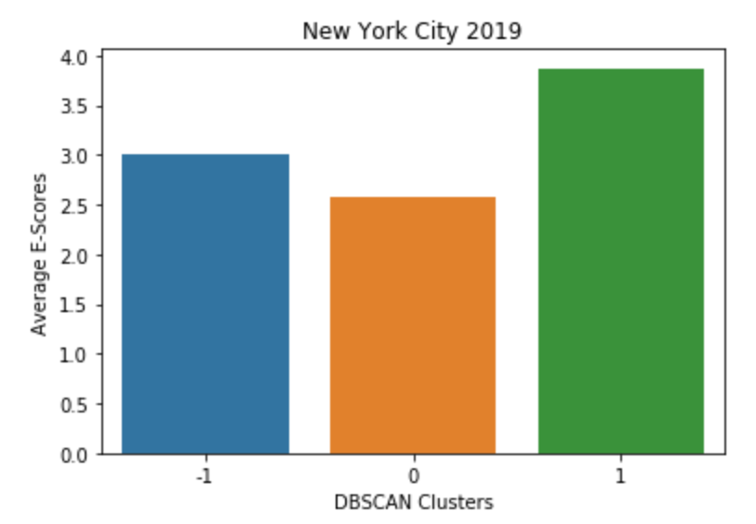
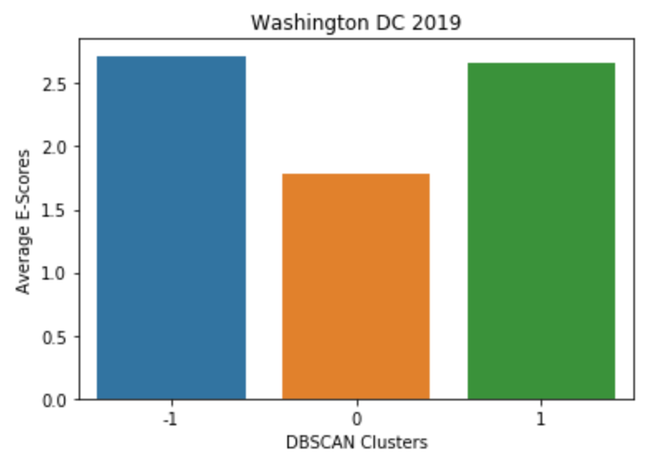
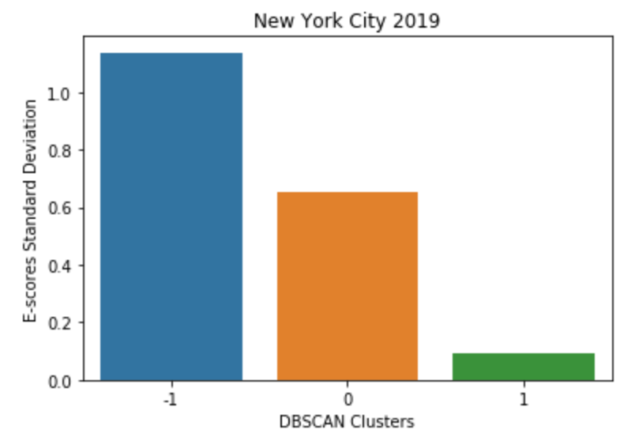
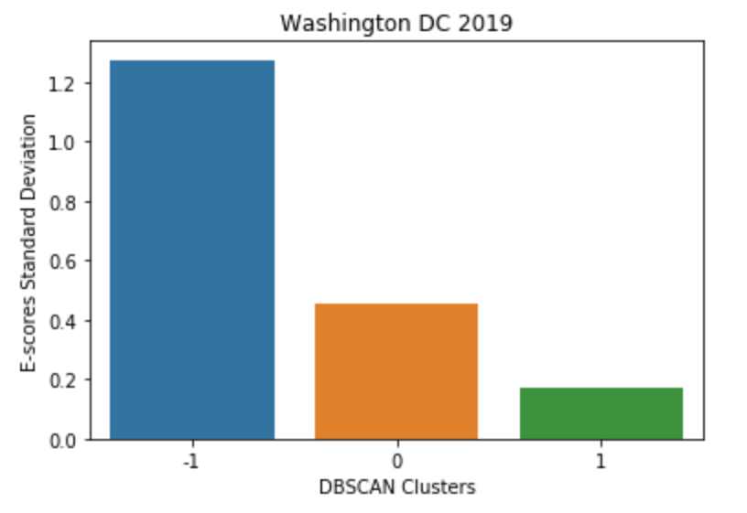

Slide 6
Degree for Polynomial Regression | Mean R² Score from Cross-Validation
 | NYC Data | DC Data
2 | 0.167 | 0.204
3 | 0.191 | -1.547
4 | 0.164 | -8.536
5 | 0.084 | -63.852

Slide 7
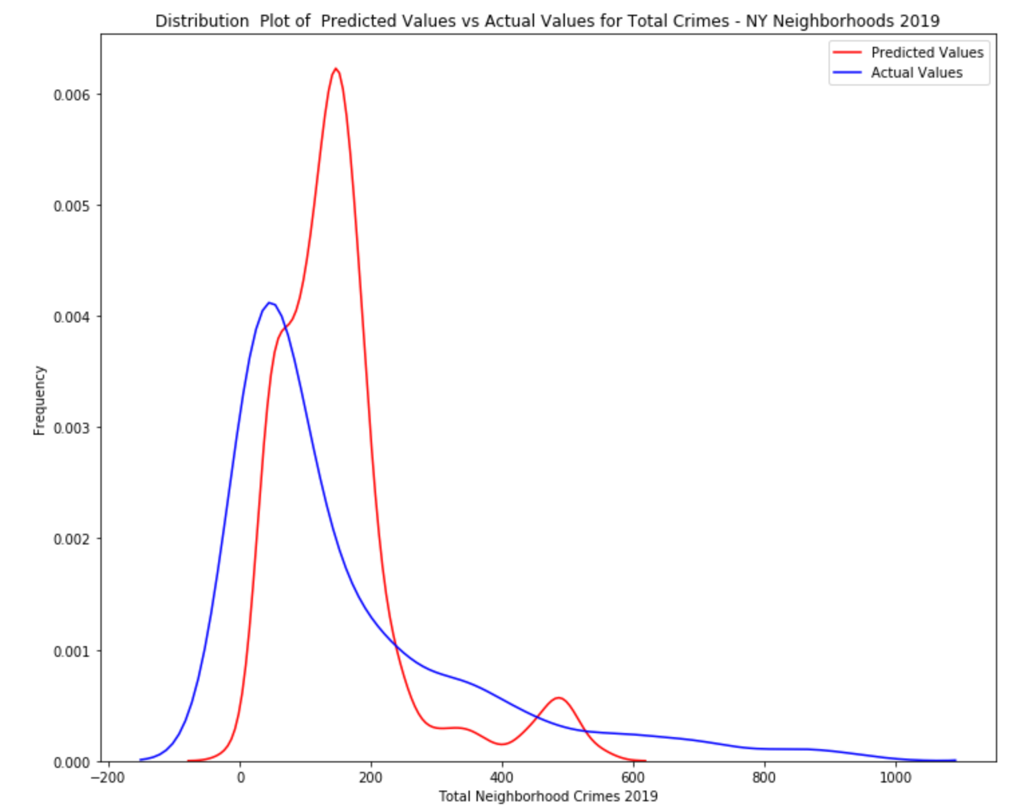
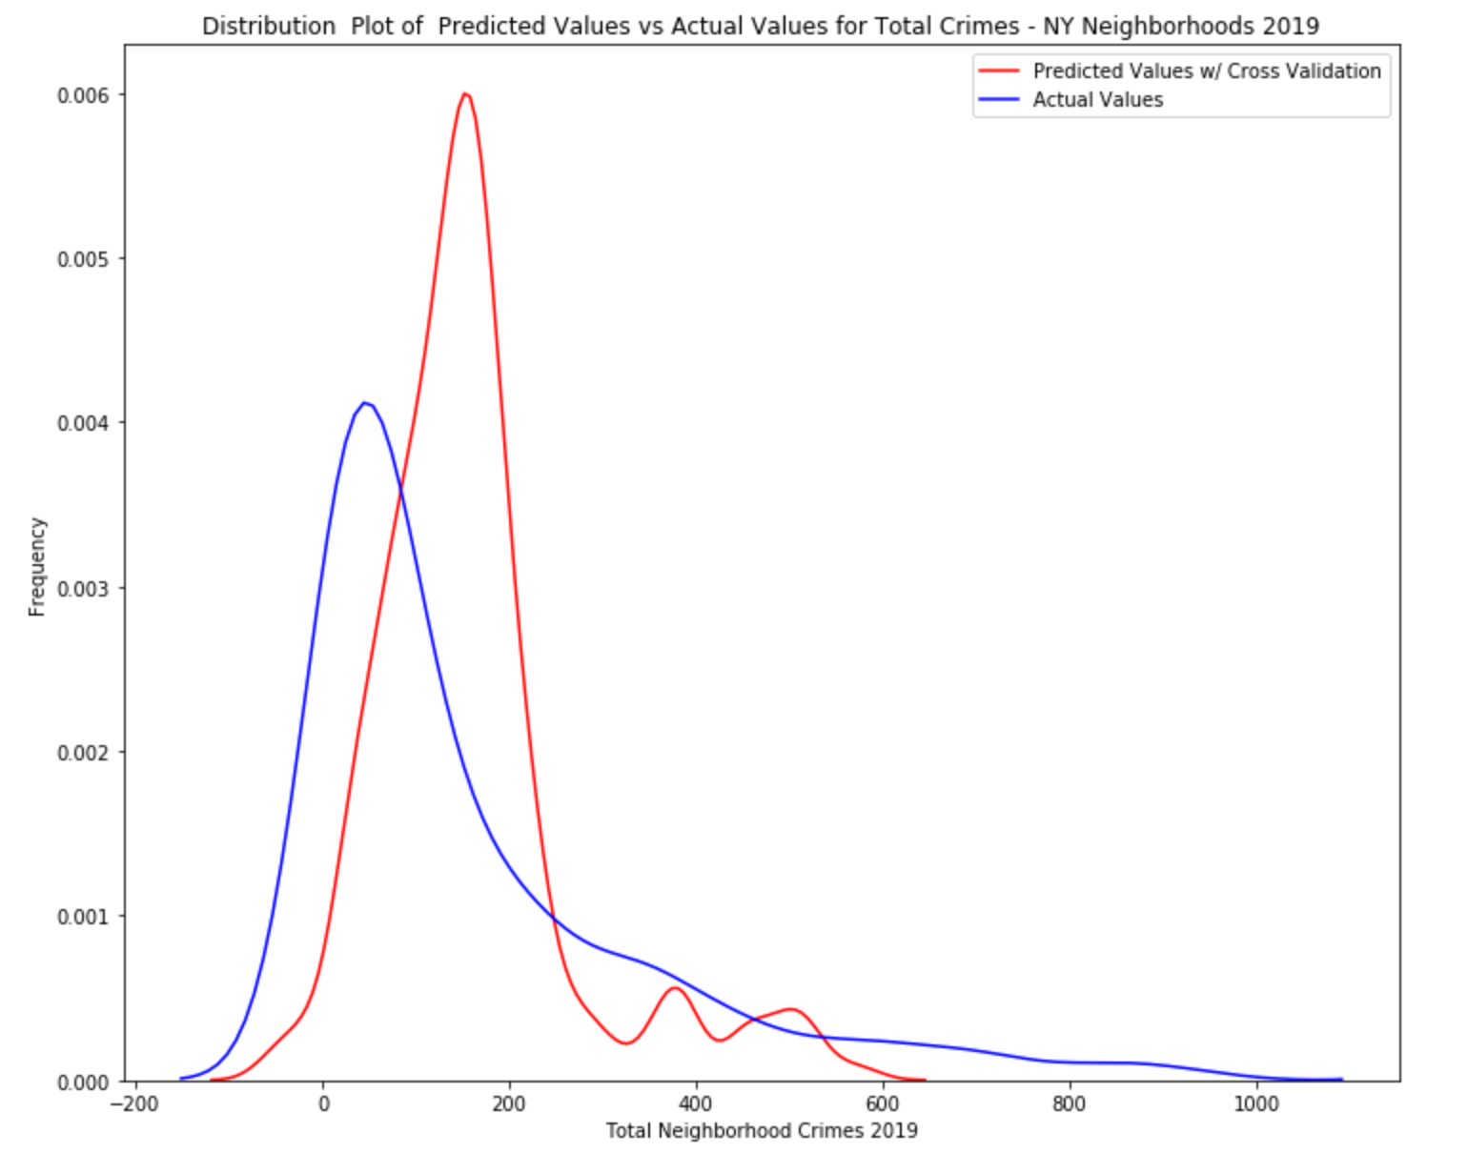
Cross validation fit

Slide 8
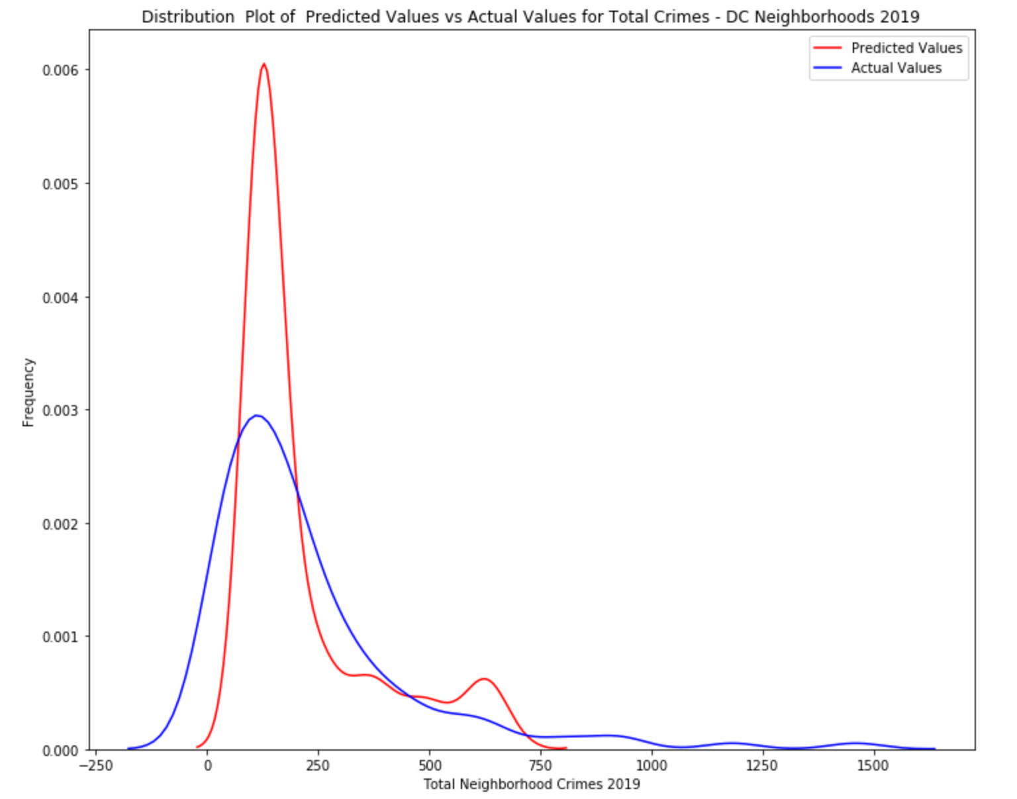
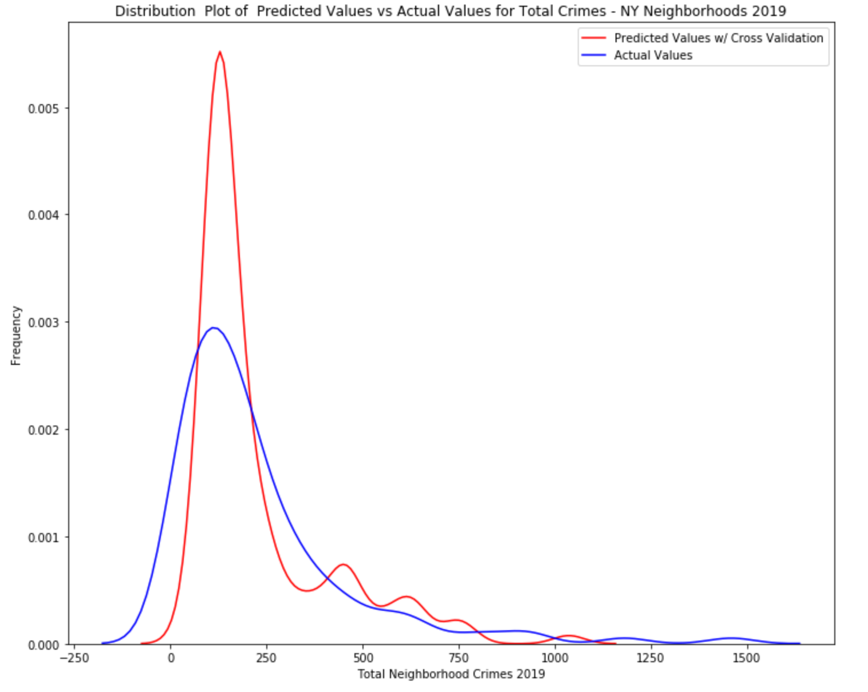
Cross validation fit

Slide 9
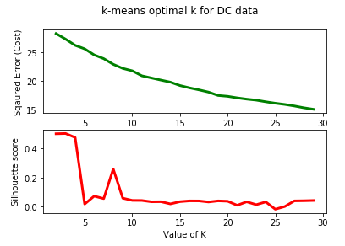

Slide 10
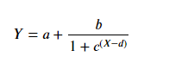

$$Escore= −\sum{\frac{N_{c}}{N}}×\log{\frac{N_{c}}{N}}$$

